Slide 1
How Using DevOps Practices Can Make You A Better Developer
Robert Green
PME DX, Microsoft
rogreen@microsoft.com
@rogreen_ms
https://channel9.msdn.com/Shows/ Visual-Studio-Toolbox

Slide 2
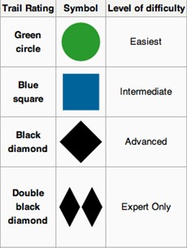
Goals For This Session
What is DevOps and why?
What is a CI/CD pipeline and why?
How do you get started using DevOps?

Slide 3
Where We Came From
Our development process
We did ask for feedback after each milestone – planning, Beta, RTM.
We did find bugs with this process and fix them - no problems there.
But we couldn’t react to anything customers using the product were telling us.
For the most part, we would tell everybody “sorry”… and push things to the next release.
Planning
Code
Test & Stabilize
Code
Test & Stabilize
?
?
Beta
RTM
2+ years

Slide 4
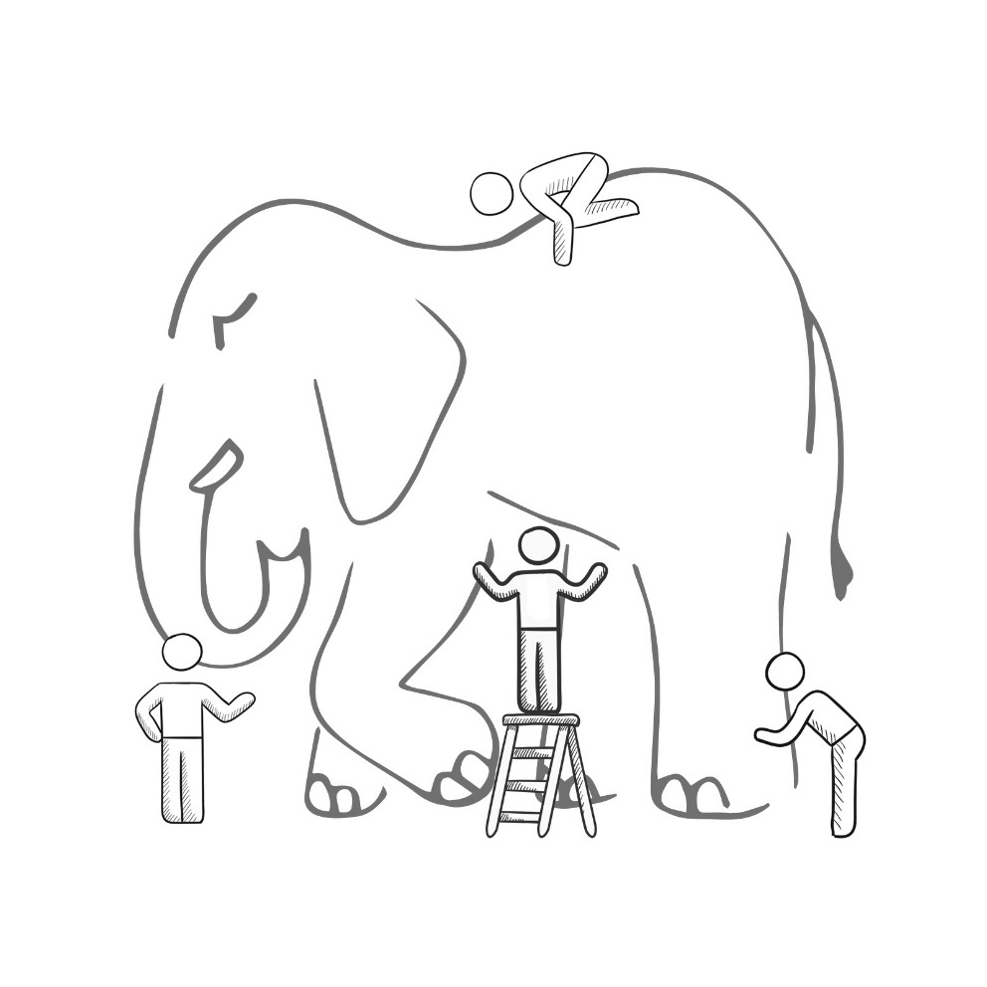
What Is DevOps?
It’s a job title
It’s automation
It’s Development and Operations collaboration
It means faster and smaller releases
Notes:
It was – and still is - the time of Agile and DevOps.
We had to formulate a DevOps strategy for our entire organization.
But what is DevOps? It can mean radically different things for different people!

Slide 5

DevOps Practices
Infrastructure as Code
Cloud Dev/Test
Automatic Scaling
Sandboxing/Dev and Test Labs
Containerization
Microservices Architecture
Automated Testing
Continuous Integration
Continuous Deployment
Release Management
Peer Code Reviews
Automated Testing
Continuous Measurement
Agile Documentation
Shift-Left into the Inner Loop
Usage Monitoring
Telemetry Collection Testing in Production
Stakeholder Feedback
FLOW OF CUSTOMER VALUE
AUTONOMY and ALIGNMENT
BACKLOG improved by LEARNING
EVIDENCE gathered in PRODUCTION
MANAGED TECHNICAL DEBT
PRODUCTION FIRST MINDSET
INFRA as a FLEXIBLE RESOURCE
Testing in Production
Usage Monitoring
User Telemetry
Stakeholder feedback
Feature flags
Experiments
Scaled Agile
Self-managing teams
Feature crews
Application Performance Management
Infrastructure as Code
Continuous Delivery
Release Management
Configuration Management
Automated Recovery
Notes:
Our DevOps journey began with the formulation of seven DevOps habits, refined over time.
DevOps habits are broad mindset changes that everybody in our organization has to actively embrace and live every day.
Let‘s look at them individually.

Slide 6
DevOps Practices
Infrastructure as Code
Cloud Dev/Test
Automatic Scaling
Sandboxing/Dev and Test Labs
Containerization
Microservices Architecture
Automated Testing
Continuous Integration
Continuous Deployment
Release Management
Peer Code Reviews
Automated Testing
Continuous Measurement
Agile Documentation
Shift-Left into the Inner Loop
Usage Monitoring
Telemetry Collection Testing in Production
Stakeholder Feedback
FLOW OF CUSTOMER VALUE
AUTONOMY and ALIGNMENT
BACKLOG improved by LEARNING
EVIDENCE gathered in PRODUCTION
MANAGED TECHNICAL DEBT
PRODUCTION FIRST MINDSET
INFRA as a FLEXIBLE RESOURCE
Testing in Production
Usage Monitoring
User Telemetry
Stakeholder feedback
Feature flags
Experiments
Scaled Agile
Self-managing teams
Feature crews
Application Performance Management
Infrastructure as Code
Continuous Delivery
Release Management
Configuration Management
Automated Recovery
Notes:
Our DevOps journey began with the formulation of seven DevOps habits, refined over time.
DevOps habits are broad mindset changes that everybody in our organization has to actively embrace and live every day.
Let‘s look at them individually.

Slide 7
Our Definition of DevOps
“DevOps is the union of people, processes and products to enable continuous delivery of value to end users.”
- Donovan Brown, Microsoft DevOps PM
DevOps encompasses
Culture
Measurement
Automation
Collaboration

Slide 8
What DevOps is NOT
It is not a product
It is not a specification
It is not centralized
It is not trademarked
“You cannot buy DevOps and install it. DevOps is not just automation or infrastructure as code. DevOps is people following a process enabled by products to deliver value to our end users.”
- Donovan Brown

Slide 9




End-to-end DevOps
1
4
Plan
Monitor + Learn
Development
Operations
2
3
Develop + Test
Release

Slide 10
Demo Set up VSTS Version Control

Slide 11
Continuous Integration (CI)
The process of automating build and testing of code every time a team member commits changes to version control
Encourages developers to share their code and unit tests by merging their changes into a shared version control repository after every small task completion
Committing code triggers automated build system to grab latest code from the shared repository and to build, test, and validate full master branch

Slide 12
Demo Continuous Integration

Slide 13
Continuous Delivery (CD)
Process to build, test, configure and deploy from a build to a production environment
Goal is to keep production fresh by achieving shortest path from availability of new code in version control or new components in package management to deployment
Minimizes time to deploy and time to mitigate or time to remediate production incidents (TTM and TTR)

Slide 14
Demo Continuous Delivery

Slide 15
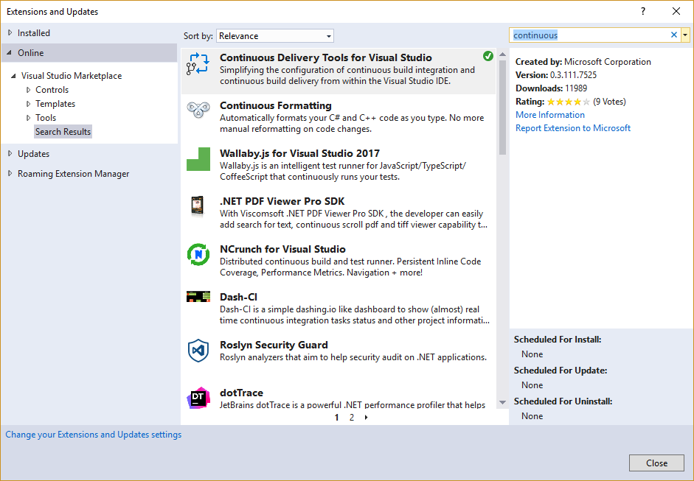
Continuous Delivery Tools for Visual Studio

Slide 16
Demo Continuous Delivery Tools for Visual Studio 2017

Slide 17
Infrastructure As Code
Management of infrastructure (networks, virtual machines, load balancers, and connection topology) in descriptive model, using same versioning as DevOps team uses for source code
IaC model generates same environment every time it is applied
Key DevOps practice used in conjunction with continuous delivery

Slide 18
Monitoring
Provides feedback from production and delivers information about application’s performance and usage patterns
Goal is to achieve high availability by minimizing time to detect and time to mitigate (TTD, TTM).

Slide 19
Review

Slide 20
References
Welcome to DevOps
https://www.visualstudio.com/devops/
Visual Studio Team Services (VSTS)
https://www.visualstudio.com/team-services/
VSTS docs
https://www.visualstudio.com/en-us/docs/build/overview
https://www.visualstudio.com/en-us/docs/build/apps/index#deploy-to-azure
Introduction to DevOps on edX
https://courses.edx.org/courses/course-v1:Microsoft+DEV212x+1T2017/

Slide 21
Questions?
Please use Events XD (EventBoard) to fill out a session evaluation.
Thank you!

